Slide 1
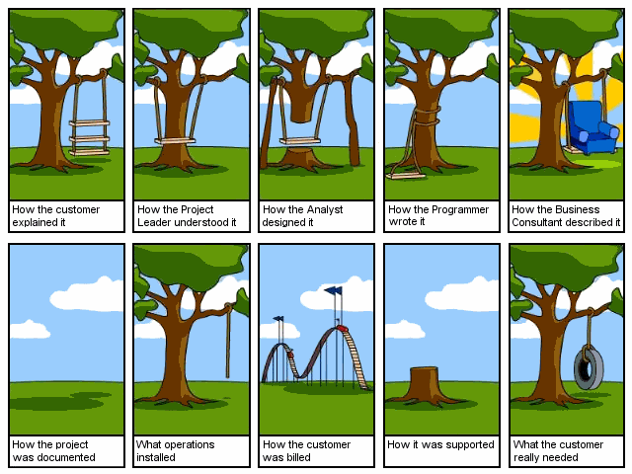
2/12/13

Slide 2

2/12/13

Slide 3
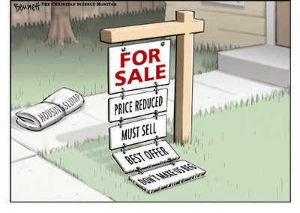
Motivation
2/12/13

Slide 4
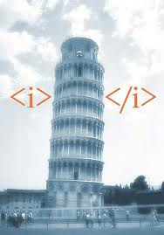
Technology and Languages
HTML5
PHP
MYSQL
APACHE
CSS3
AJAX?
2/12/13

Slide 5
Our Model
Spiral Model
Using Pivotal Tracker
Role Assignments
Weekly Meetings
2/12/13

Slide 6
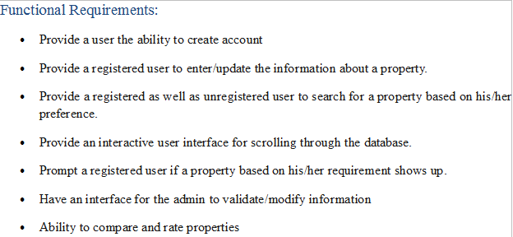
Functional Requirement
2/12/13

Slide 7
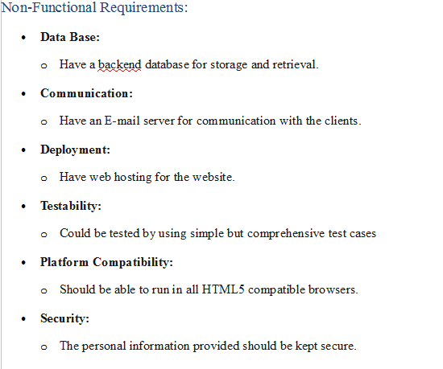
Non-Functional Requirements
2/12/13

Slide 8
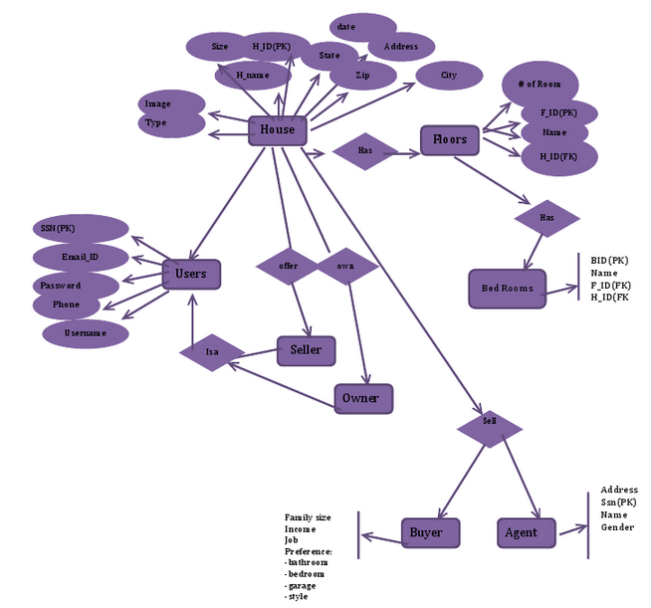
2/12/13

Slide 9
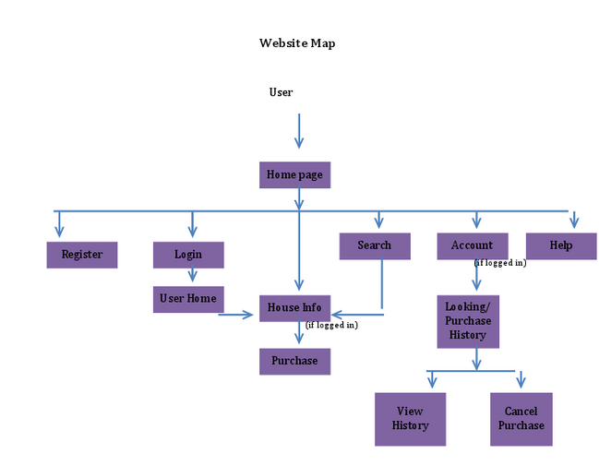
2/12/13

Slide 10
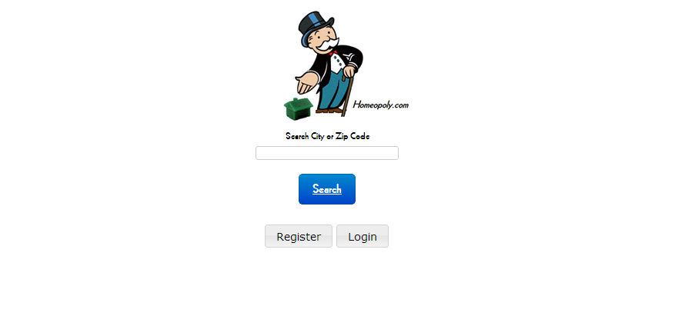
2/12/13

Slide 11
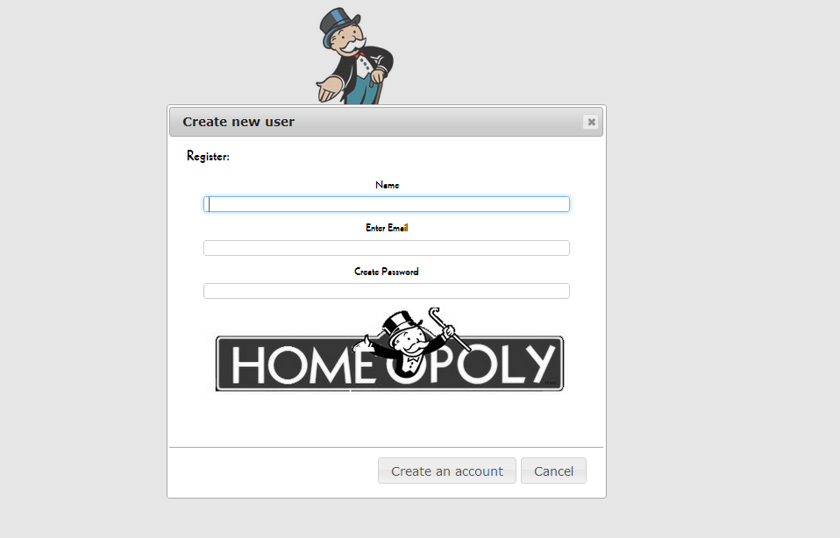
2/12/13

Slide 12
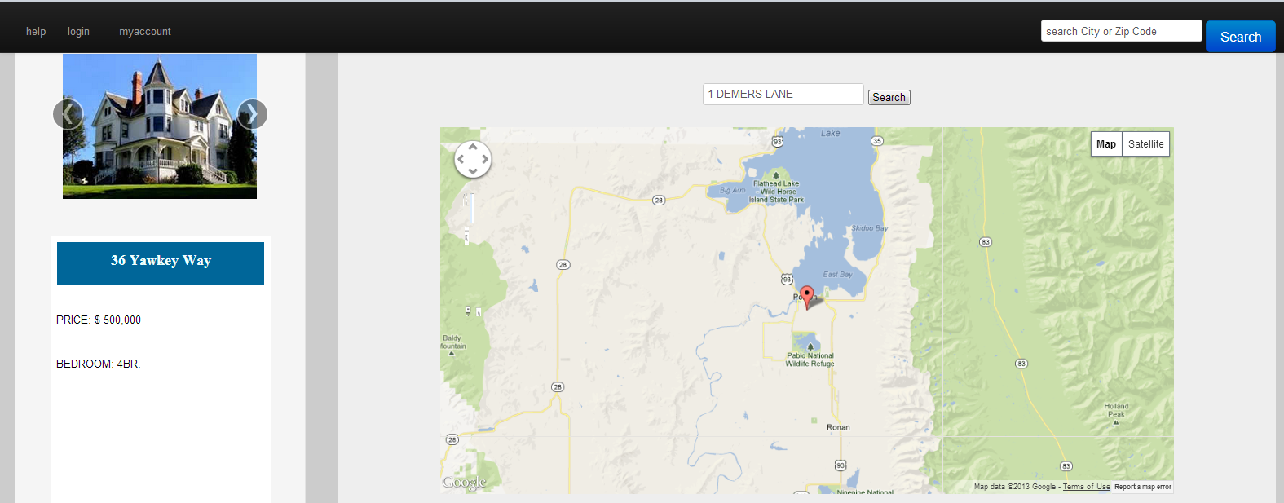
2/12/13

